Slide 1

Prediction of Household Power Consumption Using Time-Series Analysis (ARIMA & SARIMA model)
Najibah Ali

Slide 2
CRISP-DM roadmap (Cross-Industry Standard Process for Data Mining)
Deployment
Prepare, monitor, document, and maintain deployed model.
Evaluation
Assess model performance, validate, compare, and plot.
Modelling
Select, train, optimize, and interpret models.
Data Preparation
Clean, preprocess, split into sets, and transform data.
Data Understanding
Explore data structure, assess quality, and perform initial analysis for insights.
Project Understanding
Define the project objectives and goals.

Slide 3
Project Timeline Infographics Gantt Chart
Week 1
Week 2
Week 3
Week 4
Week 5
Stage 1
Understanding Project
Stage 2
Data Understanding
Stage 3
Data Preparation
Stage 4
Modelling
Stage 5
Evaluation
Stage 6
Deployment

Slide 4

Stage 1: Project Understanding

Slide 5
Problem statement
Specific – To predict the household global active power usage using ARIMA & SARIMA prediction model for time-series analysis.
Measurable - Model performance will be assessed by RMSE (Root Mean Square Error) to measure forecasting accuracy.
Achievable - The project is achievable with available references, and the data is already cleaned and organized.
Relevant -
Utility company :
Minimizing over-generation
Ensures a stable supply of electricity to customers
Match power generation with demand
Publics:
Encouraging more responsible usage
Helps households manage their energy usage more efficiently
Gain insights into power consumption patterns
Timeline - The project will be completed by July 1, 2024.
Notes:
ARIMA – Auto-regressive Integrated Moving Average
SARIMA – Seasonal Autoregressive Integrated Moving Average
RMSE - Root Mean Square Error
Notes:
For Utility Companies:
Optimization: Accurate predictions allow utility companies to better match power generation with demand, reducing inefficiencies.
Cost Savings: Minimizing over-generation and under-generation saves costs associated with energy production and storage.
Reliability: Improved forecasting helps prevent outages and ensures a stable supply of electricity to customers.
For the Public:
Awareness: Consumers can gain insights into their power consumption patterns, encouraging more responsible usage.
Cost Efficiency: Helps households manage their energy usage more efficiently, potentially reducing their electricity bills.
Sustainability: Reduces overall energy consumption, contributing to environmental sustainability efforts.

Slide 6

Stage 2: Data Understanding
Exploratory Data Analysis (EDA)

Slide 7
Table 1: The mean reading for each feature for each month
Month | Sub-meter 1 Mean
1 | 1.480
2 | 1.727
3 | 1.680
4 | 0.111
5 | 0.040
6 | 0.083
Month | Sub-meter 2 Mean
1 | 2.480
2 | 0.636
3 | 2.960
4 | 0.723
5 | 0.280
6 | 1.292
Month | Sub-meter 3 Mean
1 | 5.040
2 | 4.909
3 | 5.040
4 | 1.236
5 | 2.880
6 | 4.458
Month | Global Active Power Mean (kW)
1 | 1.431
2 | 1.096
3 | 1.185
4 | 0.645
5 | 0.543
6 | 0.723
Month | Global Reactive Power Mean (VAR)
1 | 0.092
2 | 0.128
3 | 0.089
4 | 0.148
5 | 0.105
6 | 0.127
Notes:
Example Breakdown for Sub-meters:
Sub-meter 1: Installed in a specific area of a facility, measuring the active power in kW, reactive power in kVAR, and total energy consumption in kWh.
Sub-meter 2: Positioned to monitor a particular piece of equipment, tracking its active power in kW and voltage in V to ensure it operates within specified parameters.
Sub-meter 3: Located in another distinct area, measuring current in A, voltage in V, and calculating apparent power in kVA for comprehensive energy usage monitoring.

Slide 8
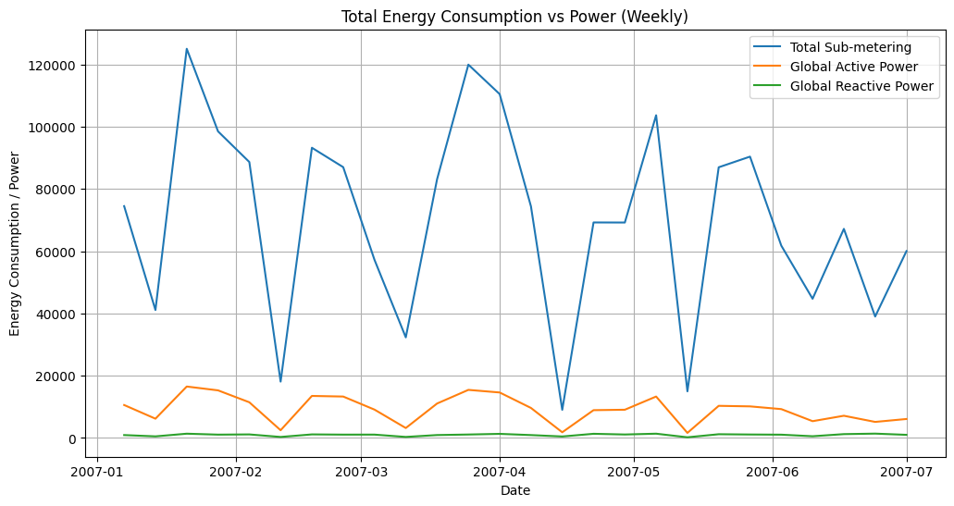
Figure 1: Weekly plotting for total energy consumption against power

Slide 9

Stage 3: Data Preparation

Slide 10
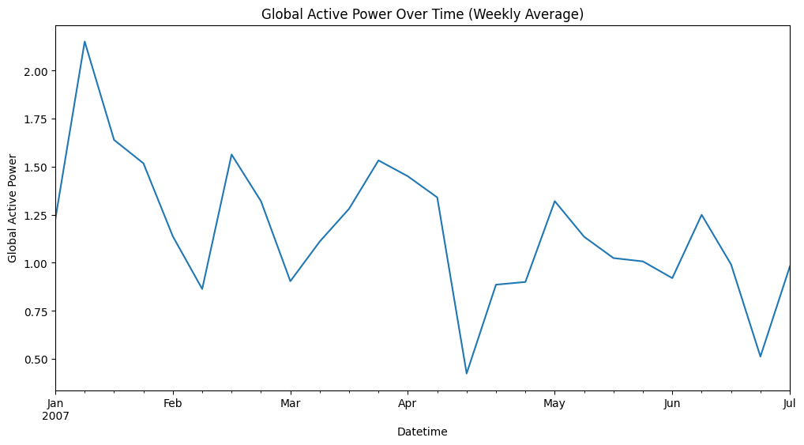
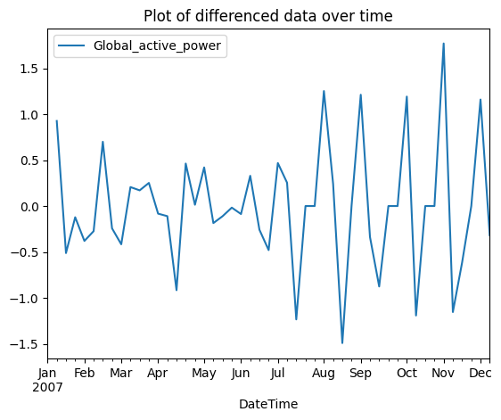
Figure 2: i) Resample the dataset into weekly
ii)Transform the dataset to be stationary

Slide 11

Stage 4: Data Modelling
ARIMA modelling
SARIMA modelling

Slide 12

Stage 4 Part 1: ARIMA Modelling

Slide 13
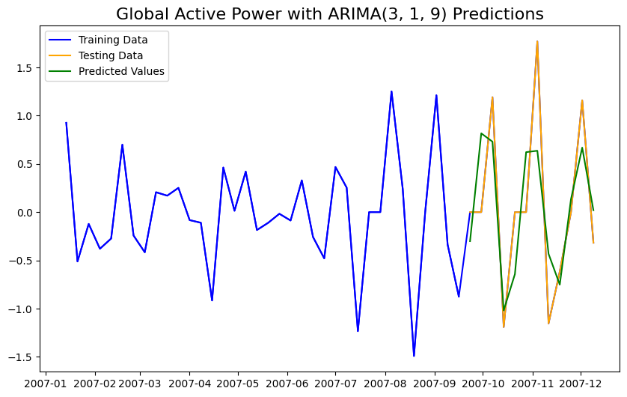
Figure 3: ARIMA prediction model compared to the test set

Slide 14
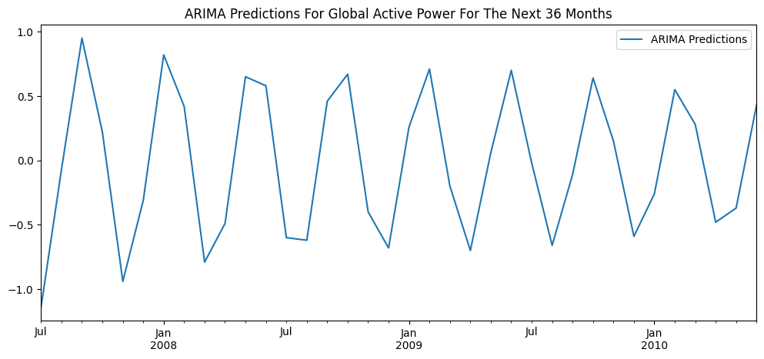
Table 2: ARIMA prediction for the next
36 months
Date | ARIMA Predictions
2007-07-01 | 1.518
2007-08-01 | 1.418
2007-09-01 | 2.338
2007-10-01 | 2.518
2007-11-01 | 1.618
2007-12-01 | 1.318
2008-01-01 | 2.098
2008-02-01 | 2.498
2008-03-01 | 1.778
2008-04-01 | 1.318
2008-05-01 | 1.908
2008-06-01 | 2.438
2008-07-01 | 1.908
2008-08-01 | 1.358
2008-09-01 | 1.758
2008-10-01 | 2.348
2008-11-01 | 2.018
2008-12-01 | 1.428
2009-01-01 | 1.638
2009-02-01 | 2.238
2009-03-01 | 2.078
2009-04-01 | 1.498
2009-05-01 | 1.548
2009-06-01 | 2.118
2009-07-01 | 2.118
2009-08-01 | 1.588
2009-09-01 | 1.488
2009-10-01 | 1.988
2009-11-01 | 2.118
2009-12-01 | 1.668
2010-01-01 | 1.458
2010-02-01 | 1.868
2010-03-01 | 2.088
2010-04-01 | 1.738
2010-05-01 | 1.458
2010-06-01 | 1.768
Figure 4: The ARIMA prediction plot for the next 36 months

Slide 15

Stage 4 Part 2: SARIMA Modelling

Slide 16
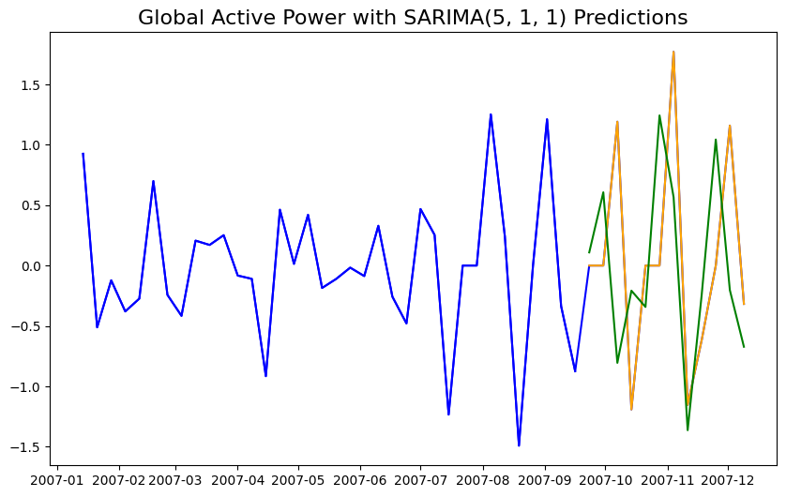
Figure 5: SARIMA prediction model (5, 1, 1) compared to the test set

Slide 17
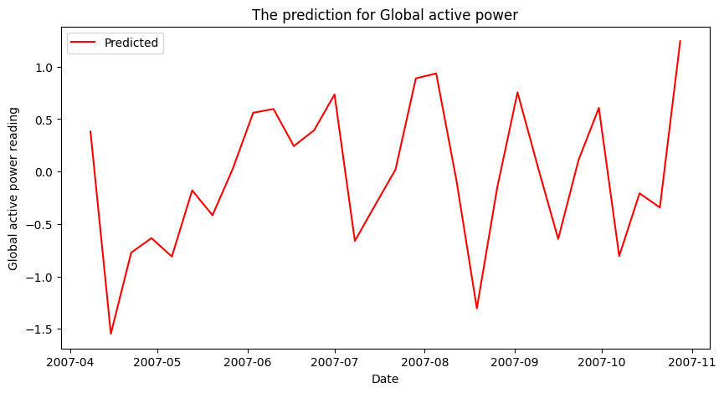
Table 3: SARIMA prediction for the next 3 months weekly
Date | SARIMA Predictions
2007-07-01 | 3.283
2007-07-08 | 2.621
2007-07-15 | 2.302
2007-07-22 | 2.321
2007-07-29 | 3.209
2007-08-05 | 4.144
2007-08-12 | 4.055
2007-08-19 | 2.750
2007-08-26 | 2.595
2007-09-02 | 3.350
2007-09-09 | 3.394
2007-09-16 | 2.751
2007-09-23 | 2.860
2007-09-30 | 3.466
2007-10-07 | 2.661
2007-10-14 | 2.453
2007-10-21 | 2.110
2007-10-28 | 3.353
Figure 6: The SARIMA prediction plot for the next 3 months

Slide 18

Stage 5: Model Evaluation
ARIMA model
SARIMA model

Slide 19
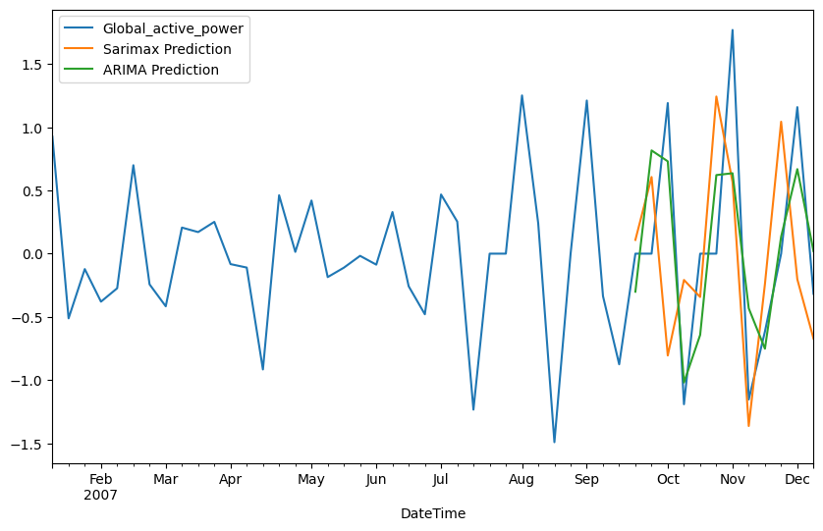
Table 4: ARIMA & SARIMA model evaluation
 | ARIMA (3, 1, 9) | SARIMA (5,1,1)(0,1,0)[12]
AIC | 62.232 | 54.009
RMSE | 0.577 | 0.988
Notes:
AIC - Akaike Information Criterion
RMSE - Root Mean Squared Error
Figure 7: The comparison between ARIMA & SARIMA prediction plot
Notes:
Aic: It balances the goodness of fit of the model and the complexity of the model.
Mae: Measures the average magnitude of the errors between predicted and actual values, without considering their direction
Mape: Expresses the error as a percentage, making it easier to interpret the relative error magnitude.
Rmse: Measures the square root of the average squared differences between predicted and actual values.
Mae: Provides a linear score , all weigh equally

Slide 20
Stage 6: Model Deployment

Slide 21
Reference
Umrajkar, V. (2022). “Electricity Consumption-Time Series Analysis”. Kaggle. https://www.kaggle.com/code/vedumrajkar/electricity-consumption-time-series-analysis/notebook
Kumar, R. (2023, Apr 1). “Let’s talk🦜about your first Time series ARIMA model 💹: Part 1”. Medium. https://blog.devops.dev/lets-talk-about-your-first-arima-model-cbfdcba1749e
L. & J. (2022, Aug 25). “How to build ARIMA models in Python for time series prediction”. JustintoData. https://www.justintodata.com/arima-models-in-python-time-series-prediction/
Hebbar, N. (2020, Sep 18). “Time Series Forecasting With ARIMA Model in Python for Temperature Prediction”. Medium. https://medium.com/swlh/temperature-forecasting-with-arima-model-in-python-427b2d3bcb53

Slide 22

Thank you
Notes:
Future Work
The work never ends. Tell them what you’d like to keep working on, how this project can continue to add value to the organization in the future. Tell them how it can get better.

